Slide 1
NATIONAL RAILWAY RESERVATION SYSTEM
DBS LAB PROJECT
M. VAISHNAVI 15CS01011
M. SWARNA BHARATHI 15CS01018

Slide 2
REQUIREMENT SPECIFICATION
SOFTWARE:
UI – HTML, CSS, JavaScript, jQuery
Server side – PHP
Database – XAMPP (MariaDB, MySQL for RDBMS)
USER REQUIREMENTS:
Train enquiry
Ticket booking
Ticket information
Ticket cancellation
ADMIN REQUIREMENTS:
Manage database with operations like -
Add trains
Add stations
Add classes
Ticket enquiry

Slide 3
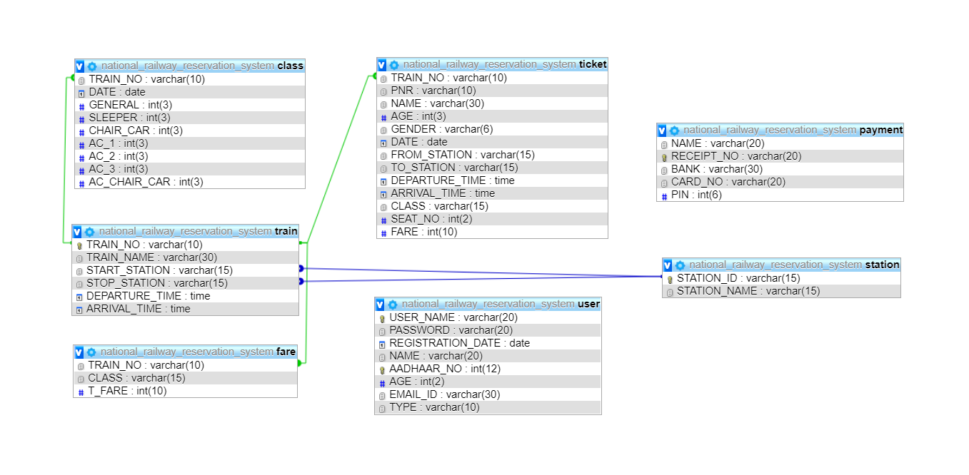
DATABASE DESIGN INCLUDING CONSTRAINTS AND TRIGGERS

Slide 4
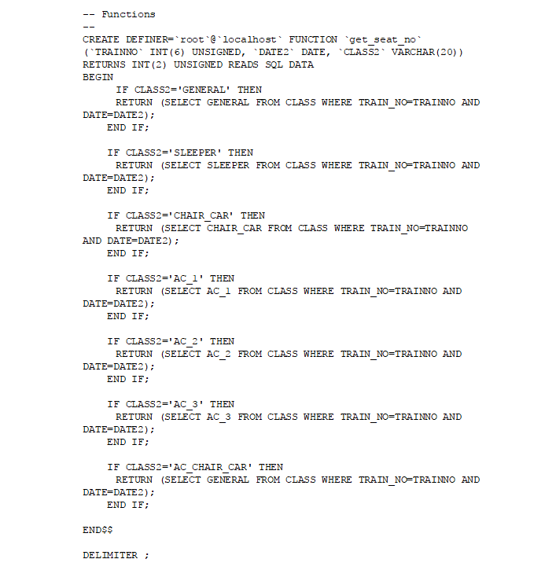
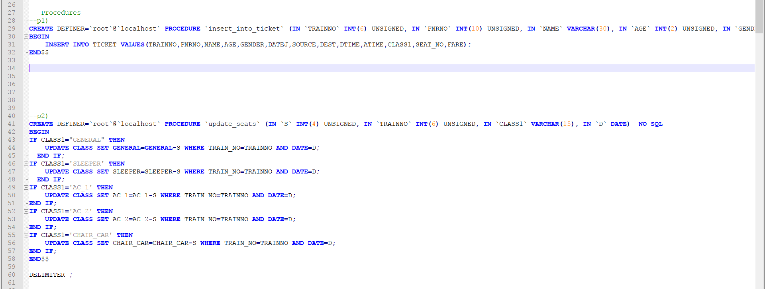
The Functions, Procedures and Triggers used:
Function
Procedure

Slide 5
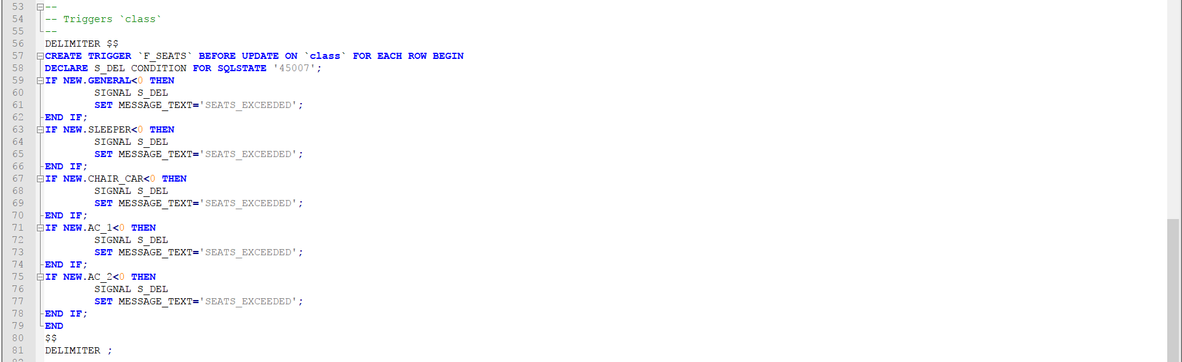
Trigger

Slide 6
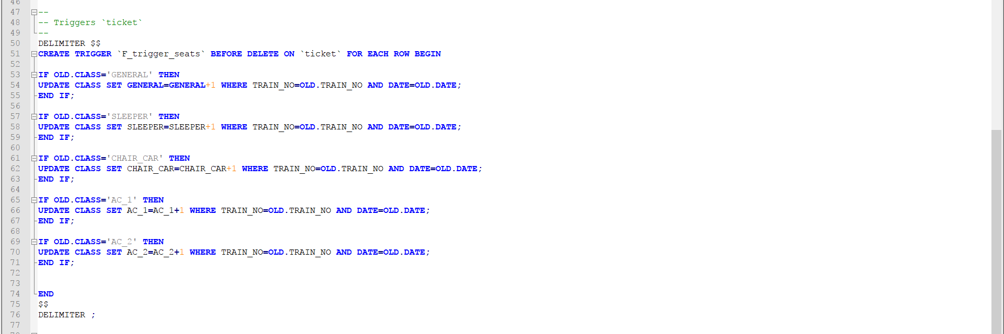
Trigger

Slide 7
DEMO
The stepwise execution of each operation is shown in the following slides.
Operations include –
Login, Train enquiry, Ticket booking, Checking ticket information, Ticket cancellation, and Logout by the user.
Login, Addition of trains, stations, classes, fares and Logout by the Admin.

Slide 8
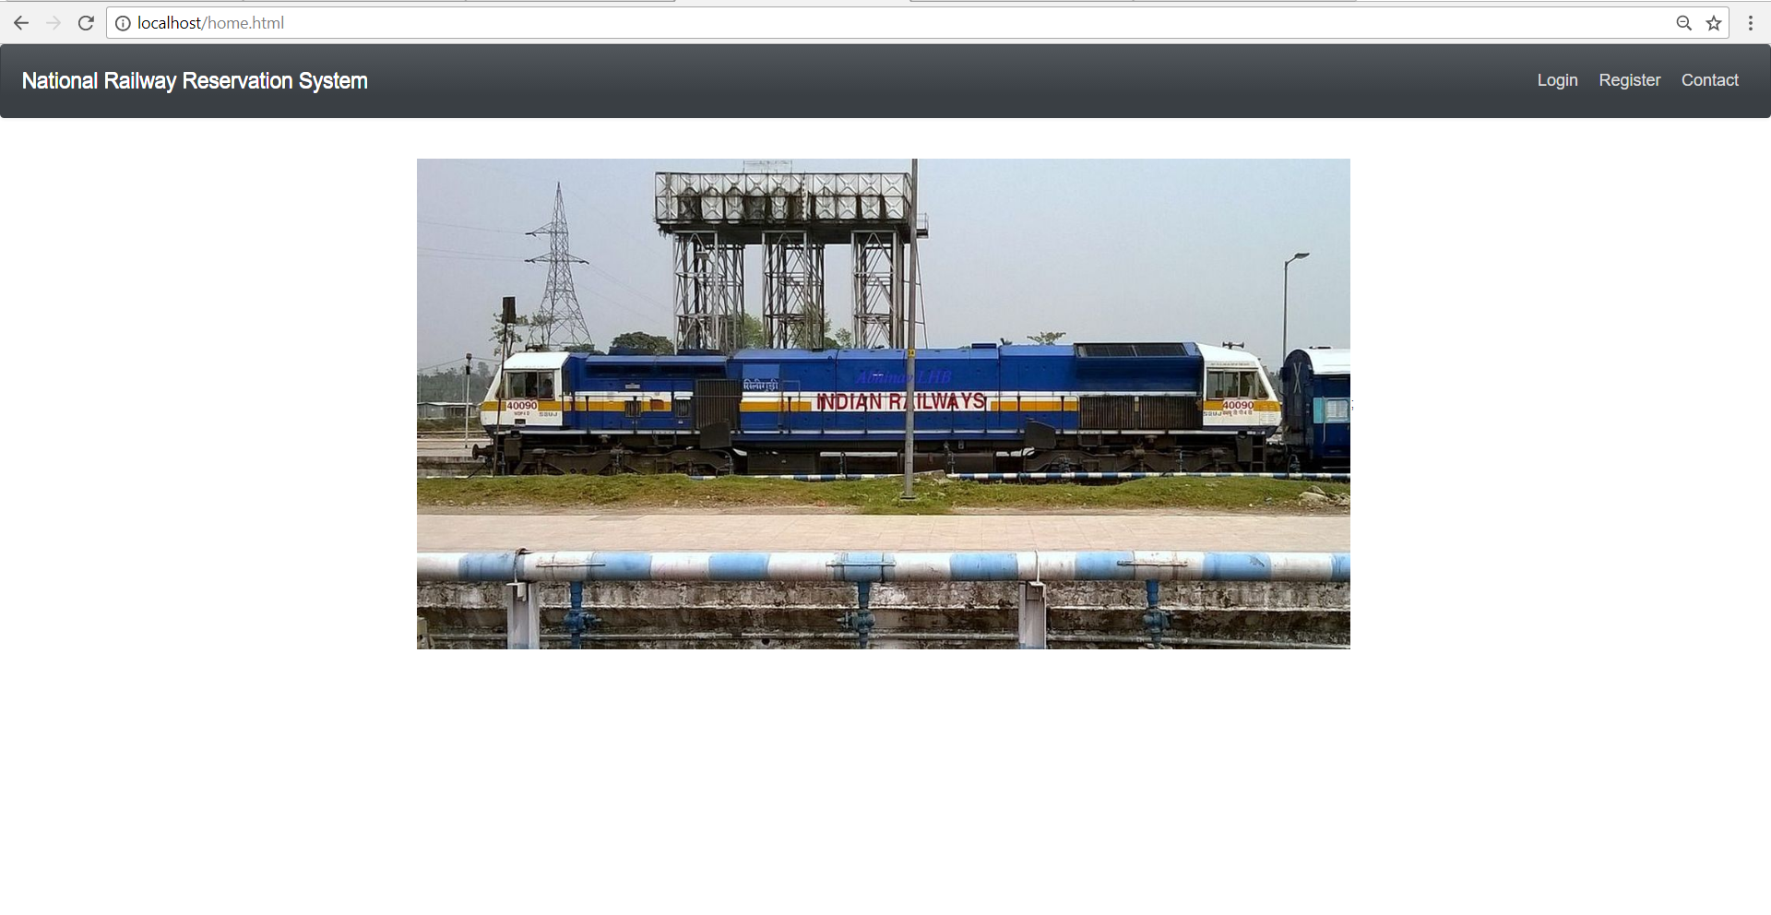
This is the home page of the project. The user can choose to login or register here.

Slide 9
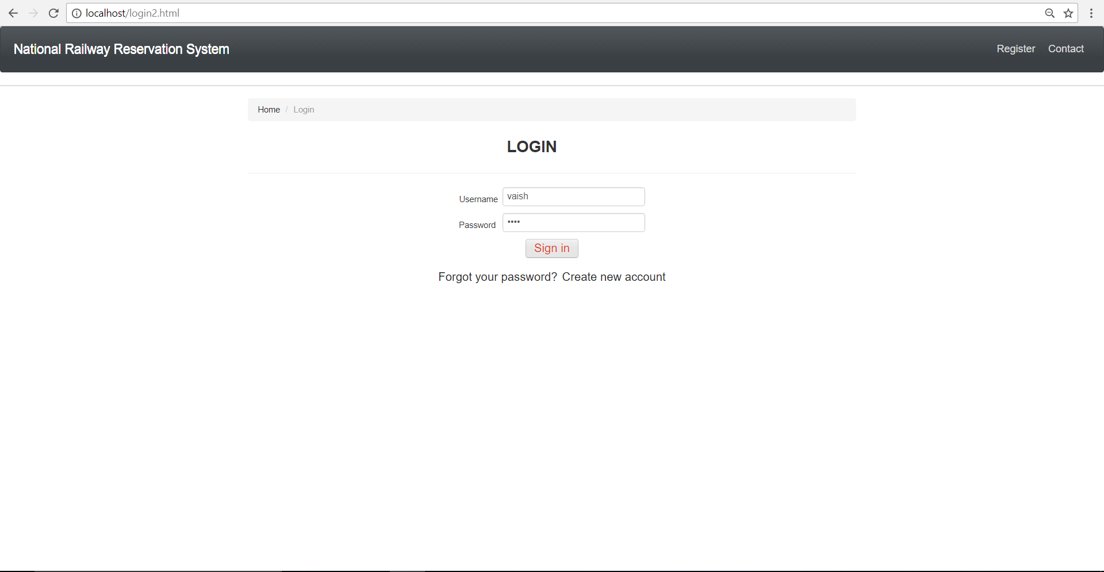
1. Login page where a user/admin has to enter details to get access to operations.

Slide 10
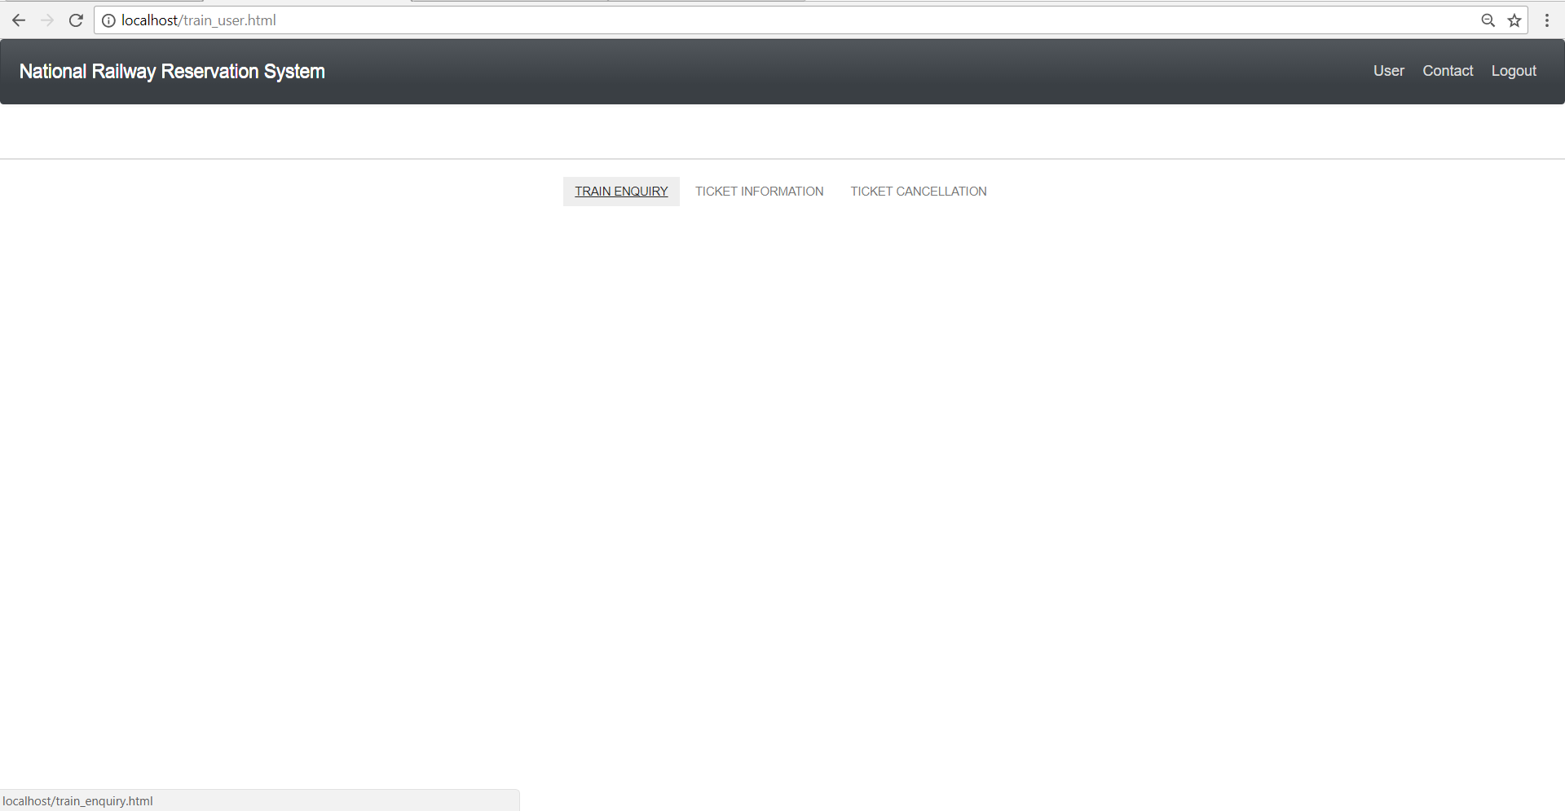
2. A user has to enter her/his details (the registered details) to login. Three options available are Train enquiry, Ticket information, and Ticket cancellation.

Slide 11
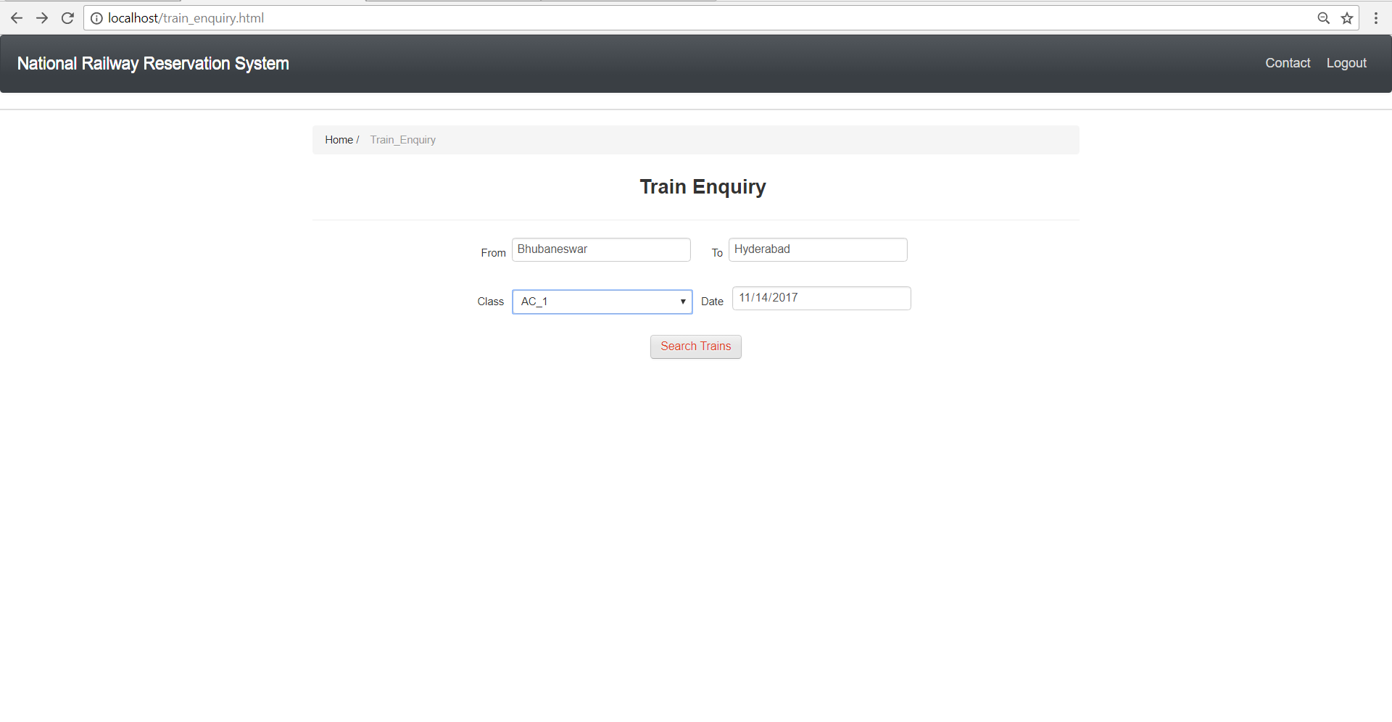
3. When Ticket enquiry is chosen, the user is navigated to a new page as shown. The user can enter the ‘From’ and ‘To’ station details, along with the preferred ‘Class’ and ‘Date’ of journey. On clicking ‘Search Trains’, the user is navigated to the next page.

Slide 12
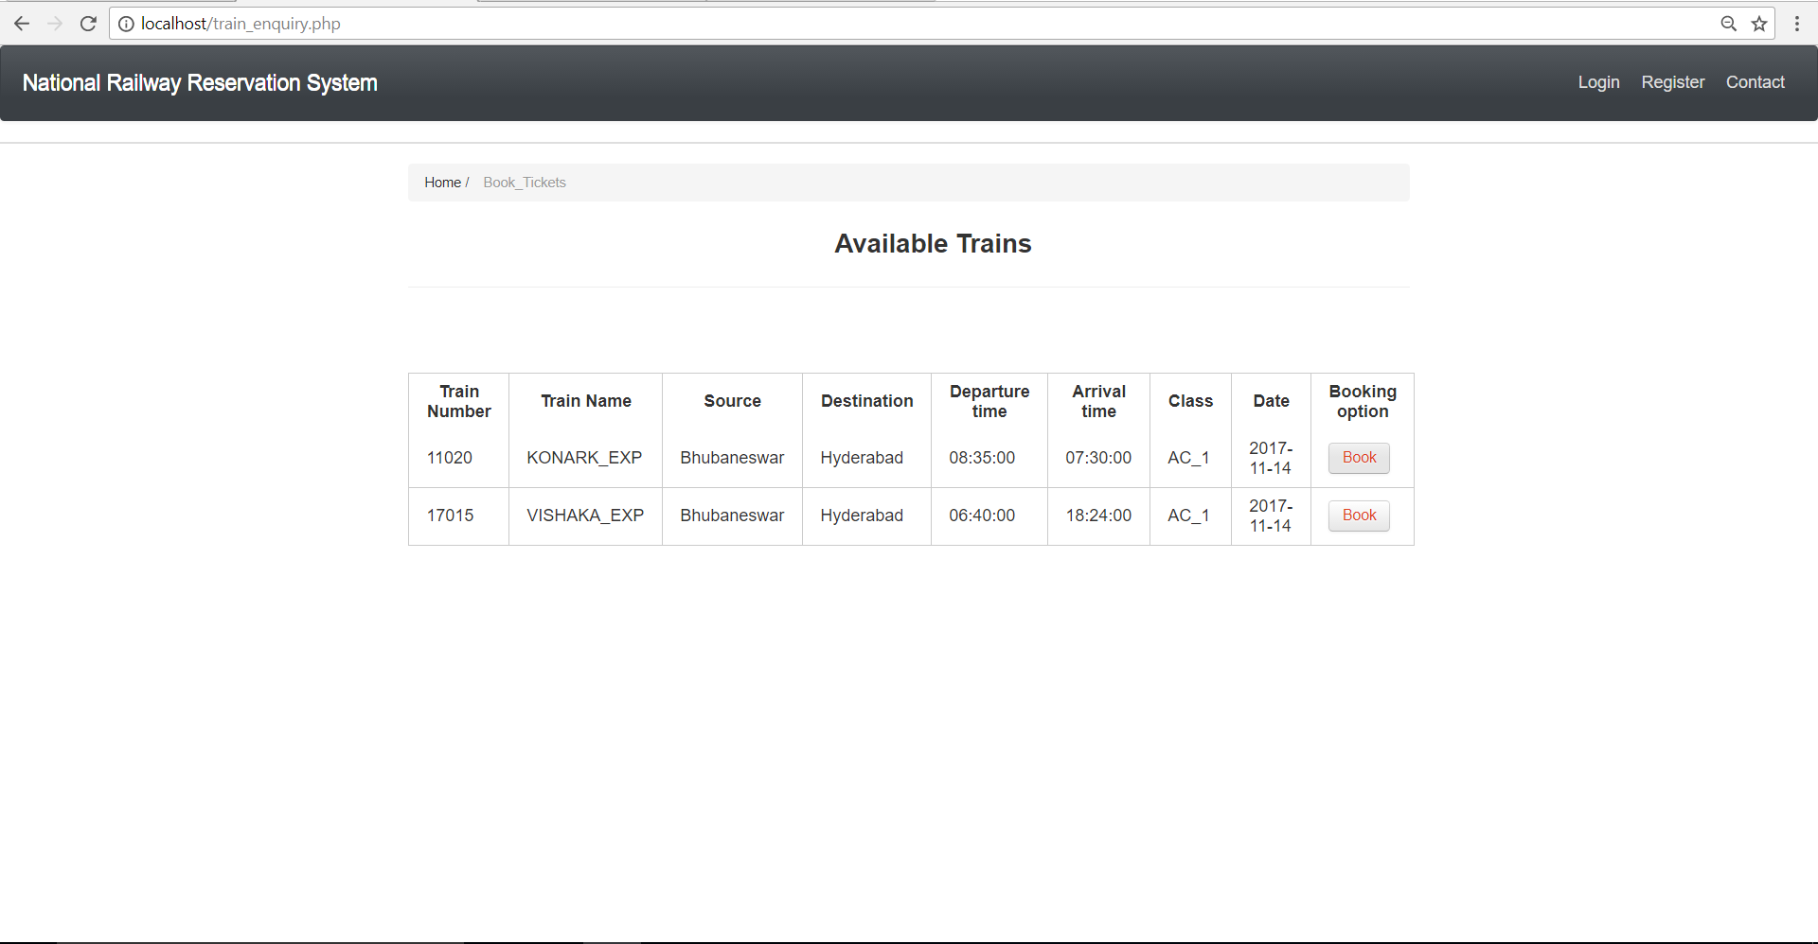
4. Here, the user is provided with options of the trains that satisfy his requirements. For each train displayed, a choice of booking tickets is provided. A click on the ‘Book’ corresponding to a desired train is required.

Slide 13
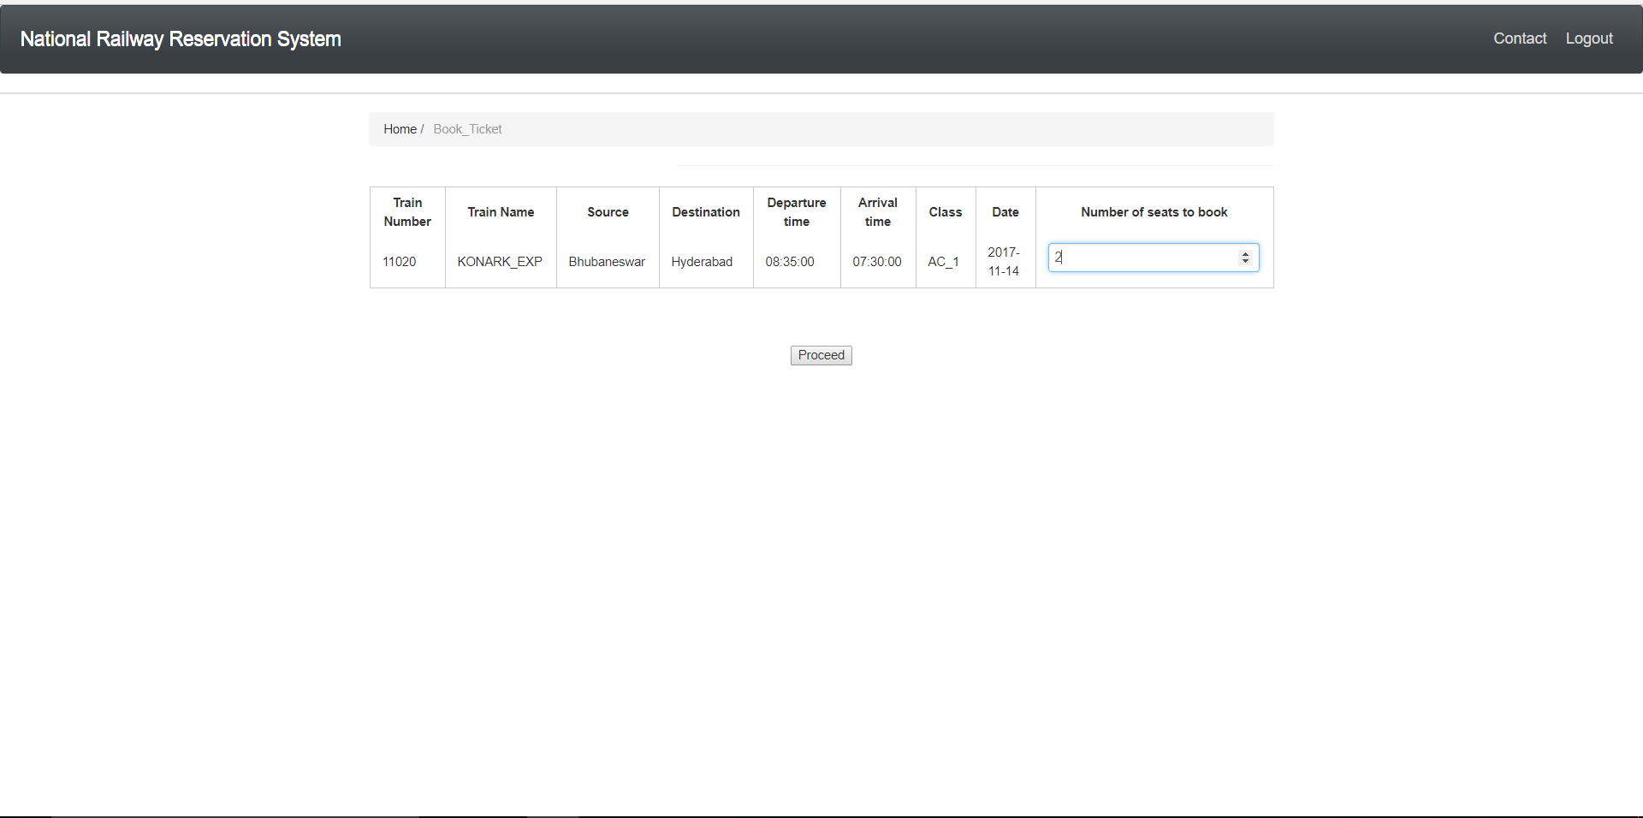
5. On clicking ‘Book’ the user is navigated to a page where information about the number seats to be booked is asked. After entering the number and clicking on ‘Proceed’, the user is navigated to a page where the passenger details are collected. If the desired number of seats are not available, an alert is encountered mentioning that the desired number of seats are not available. The user can navigate back to the previous page.

Slide 14
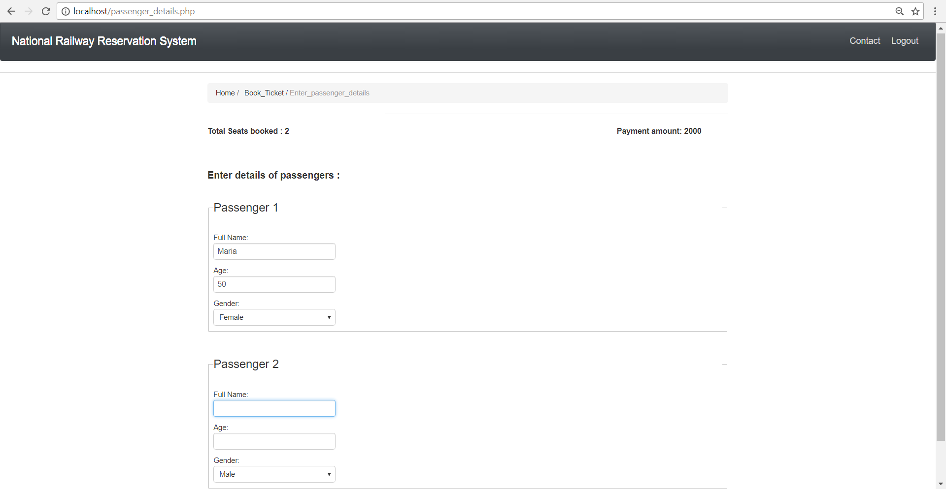
6. Total seats booked and Payment amount details are displayed. The details for the entered number of passengers are asked.

Slide 15
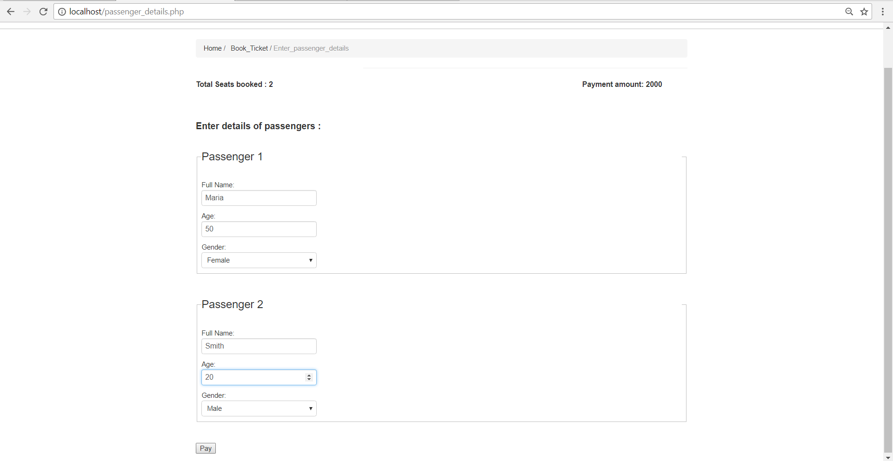
7. After entering the details, the user has to click on the pay option. NOTE: We have not designed the payment portal as it is complicated. We have included it in our future plans.

Slide 16
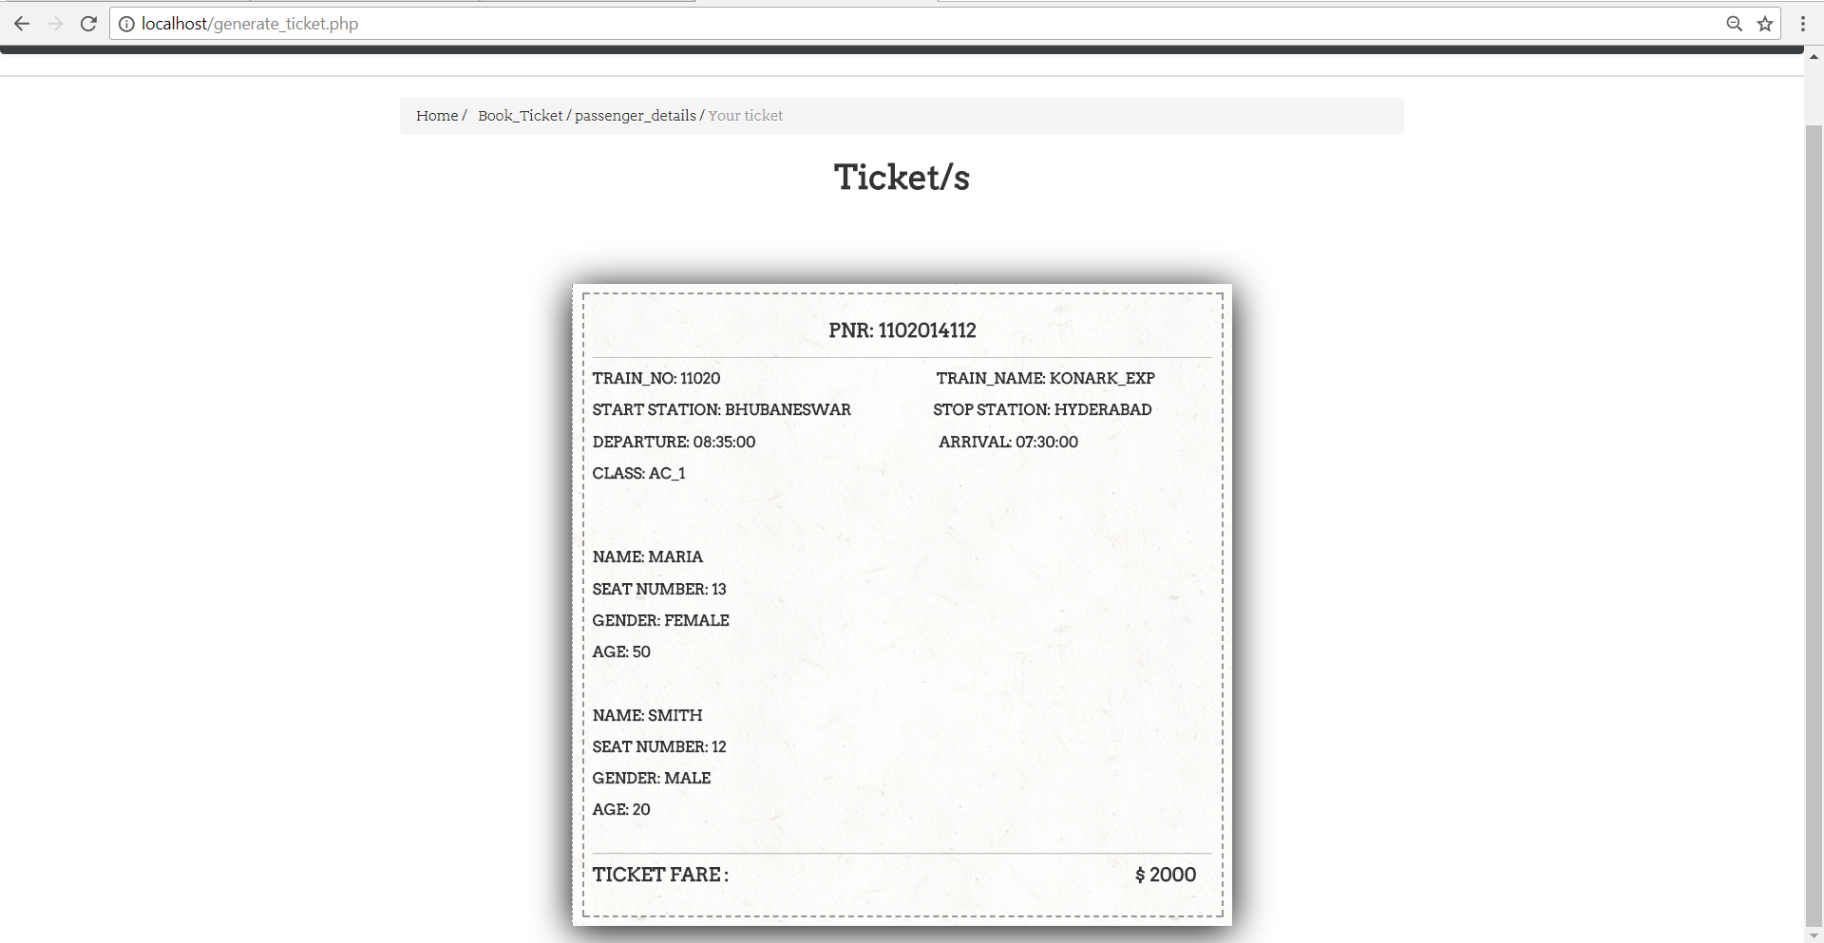
Here is the ticket that will be generated.

Slide 17
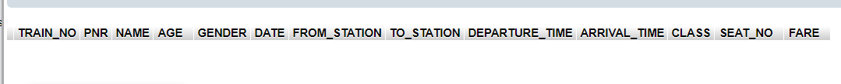
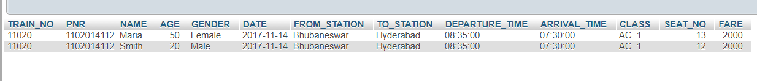
8. On clicking ‘Pay’, the user is navigated to this page where the ticket is display. These details are set into the ticket table in the database. Also, the number seats corresponding to that particular class (train and date) is reduced based on the number of seats booked. Here you see the before and after insertion in ticket table when ‘Pay’ in clicked.

Slide 18
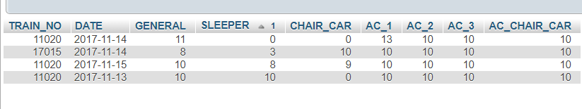
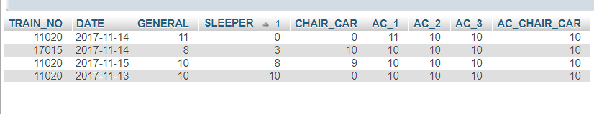
Here you see the before and after update on the ‘class’ table when ‘Pay’ in clicked.

Slide 19
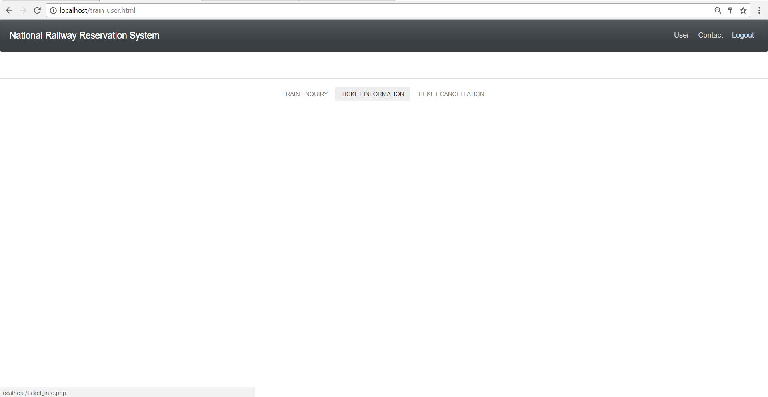
9. Next, if user wants to check the information of a booked ticket, he/she can do so by choosing the Ticket Information link here.

Slide 20
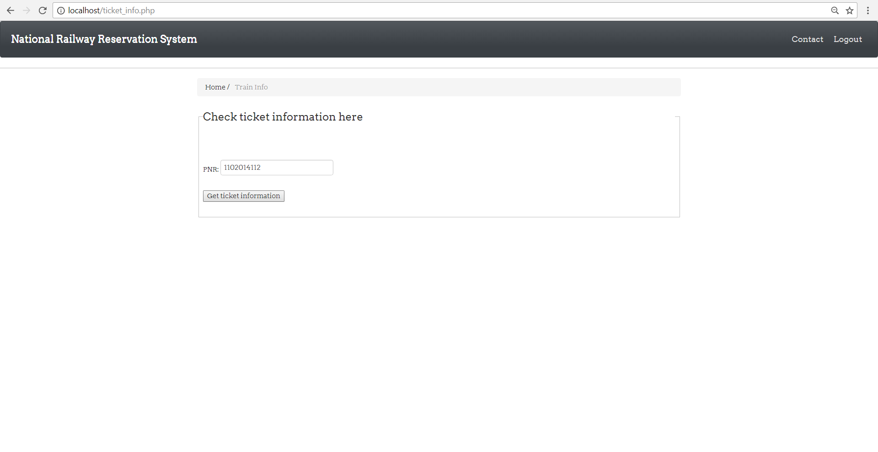
10. The user is supposed to enter a PNR number and click on ‘Get ticket information’ to get the information.

Slide 21
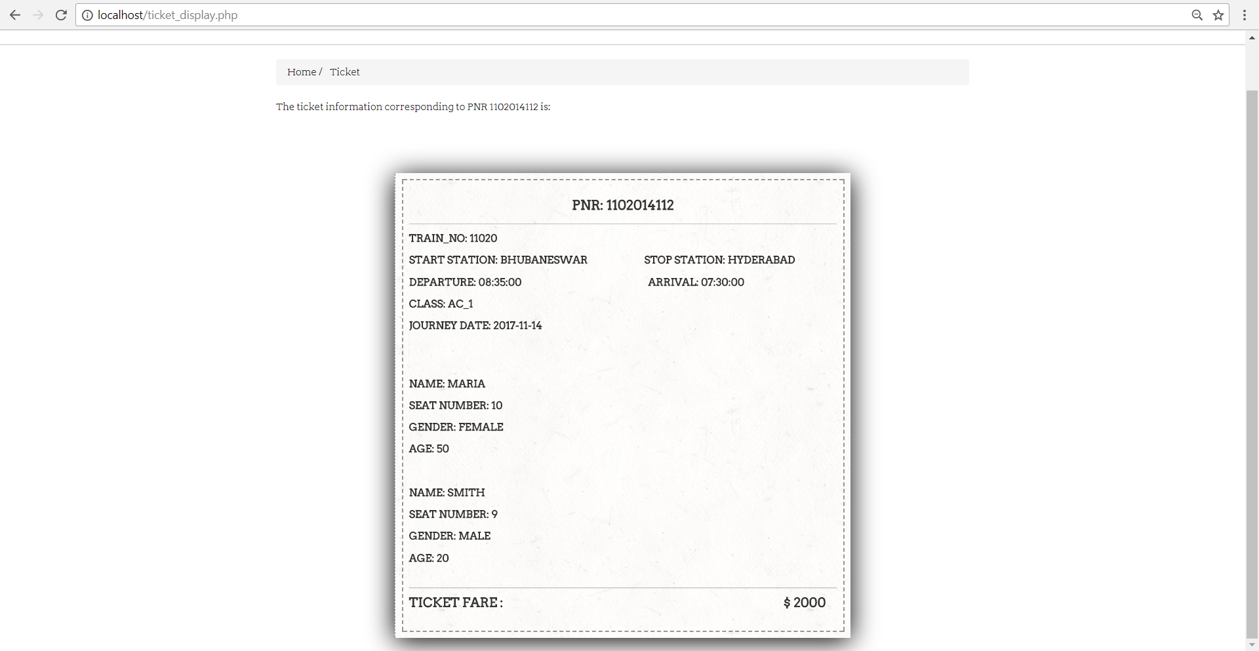
11. On clicking the user is navigated to a page where the details of the booked ticket is shown.

Slide 22
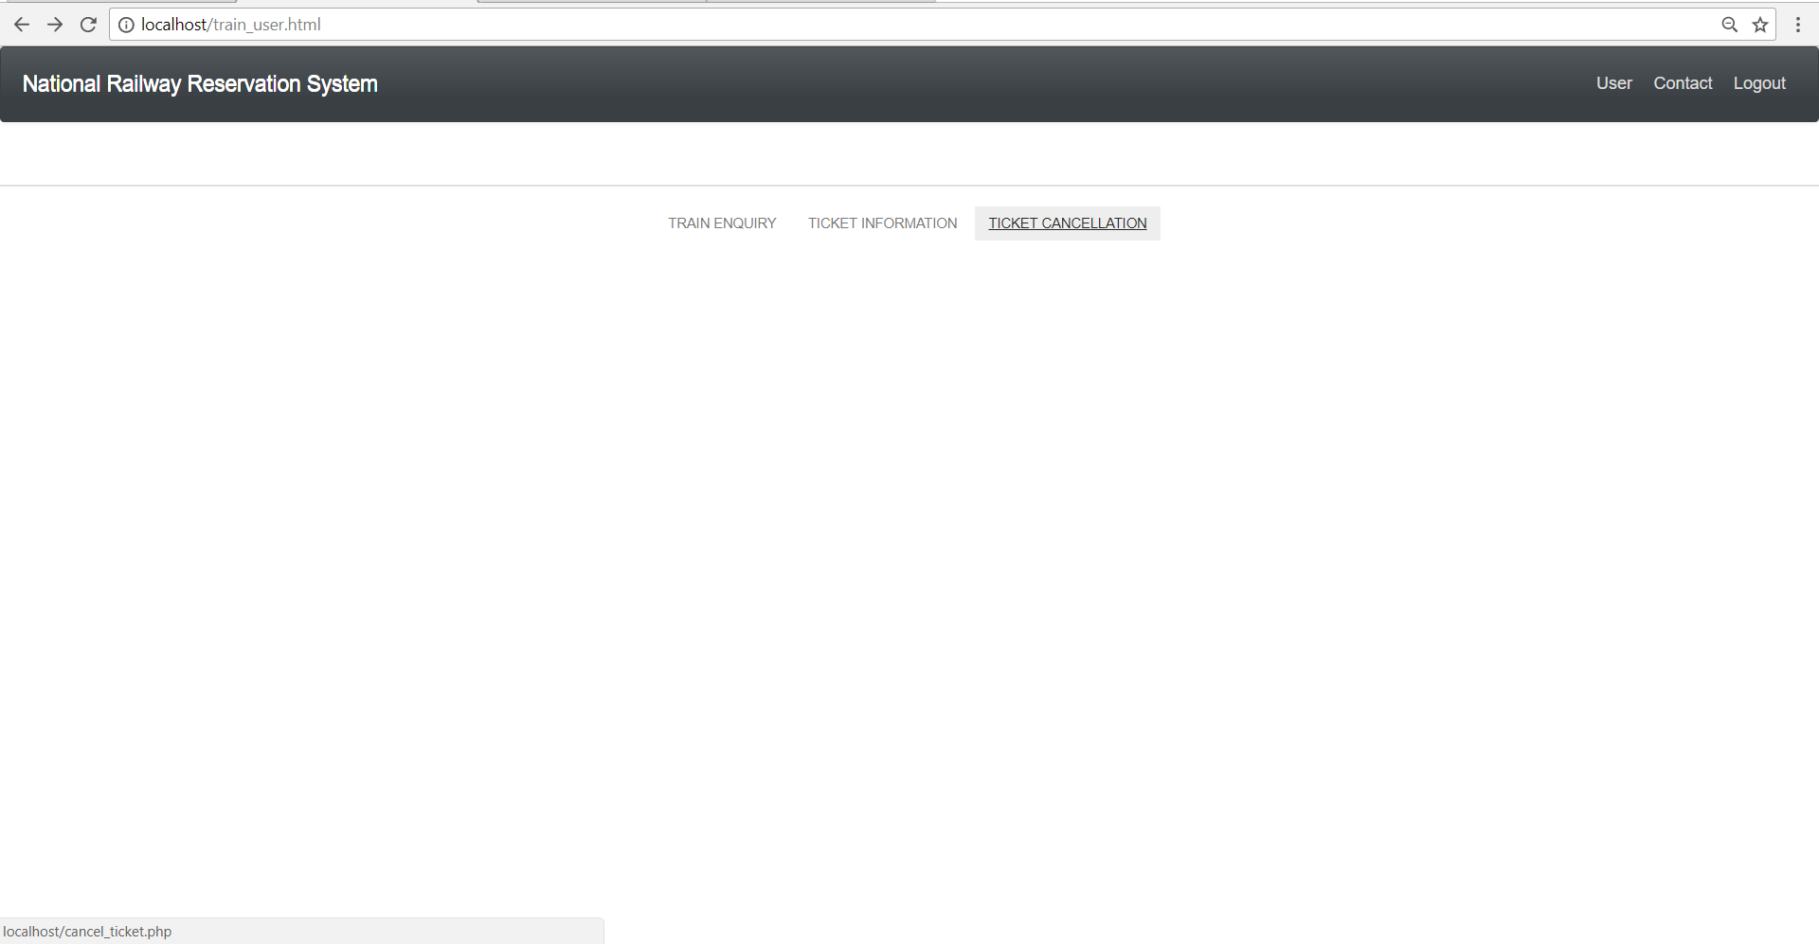
12. The user has an option of cancelling the ticket which was booked already. For this, the user should choose the link ‘Ticket Cancellation’.

Slide 23
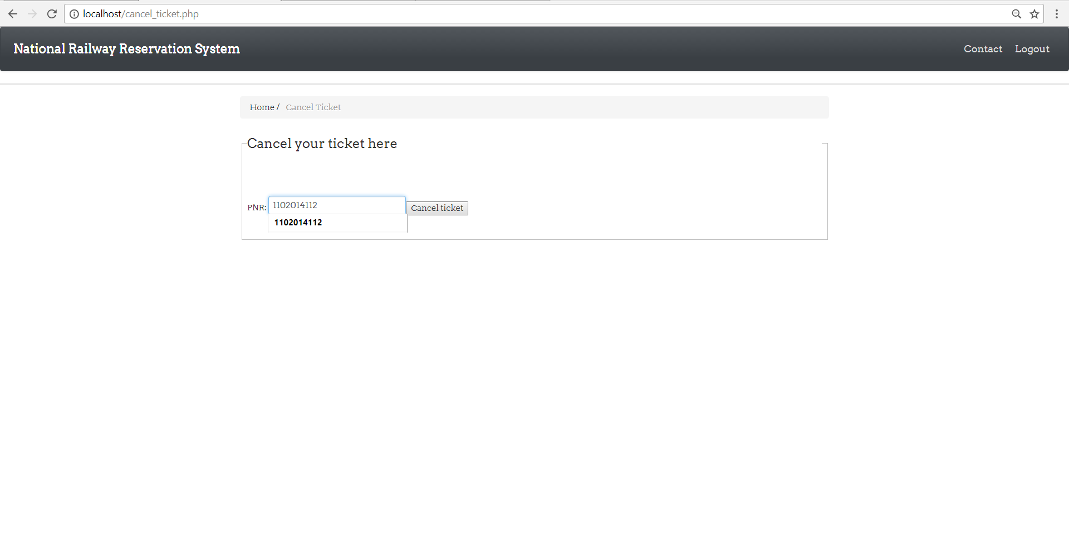
13. For cancellation, the PNR corresponding to that particular ticket is to be entered. In case a correct PNR is entered, the page display is as follows.

Slide 24
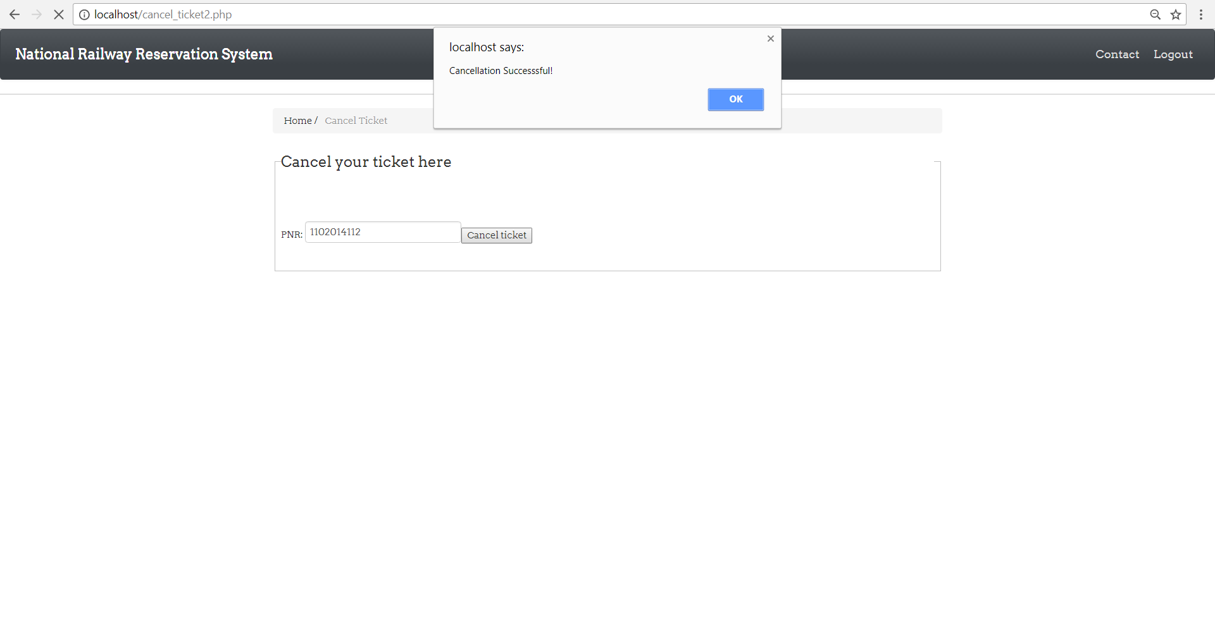
14. If the cancellation is successful, an alert box appears with message as shown.

Slide 25
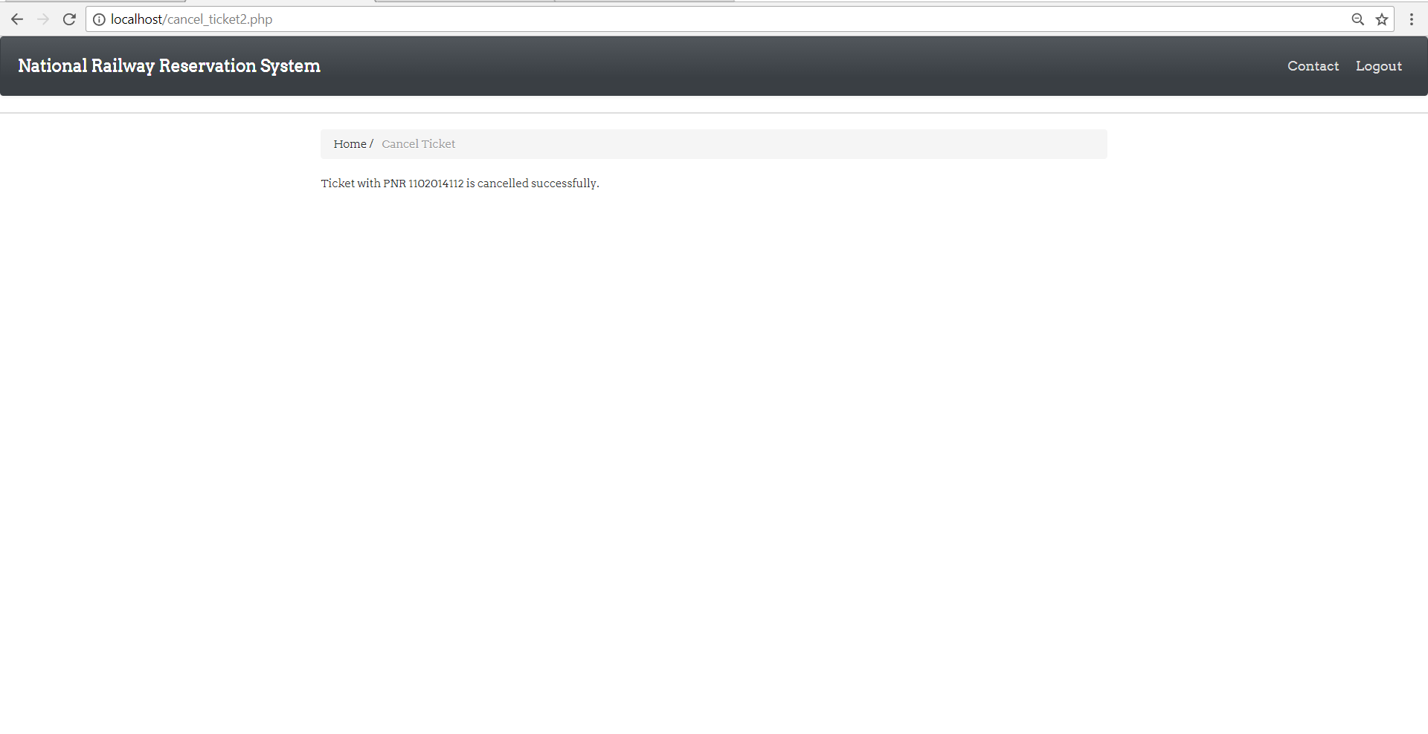
Also, the page with the following message appears.

Slide 26
The before and after screenshot of the ticket table is shown.

Slide 27
The before and after screenshot of the ‘class’ table is shown. Recovery of the available seats is done when a ticket is cancelled.

Slide 28
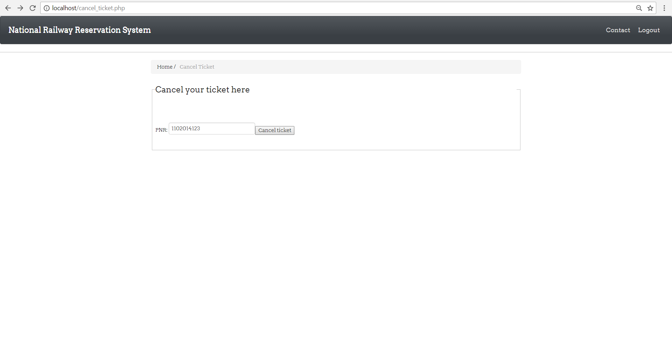
15. A case of entry of PNR that does not exist might occur.

Slide 29
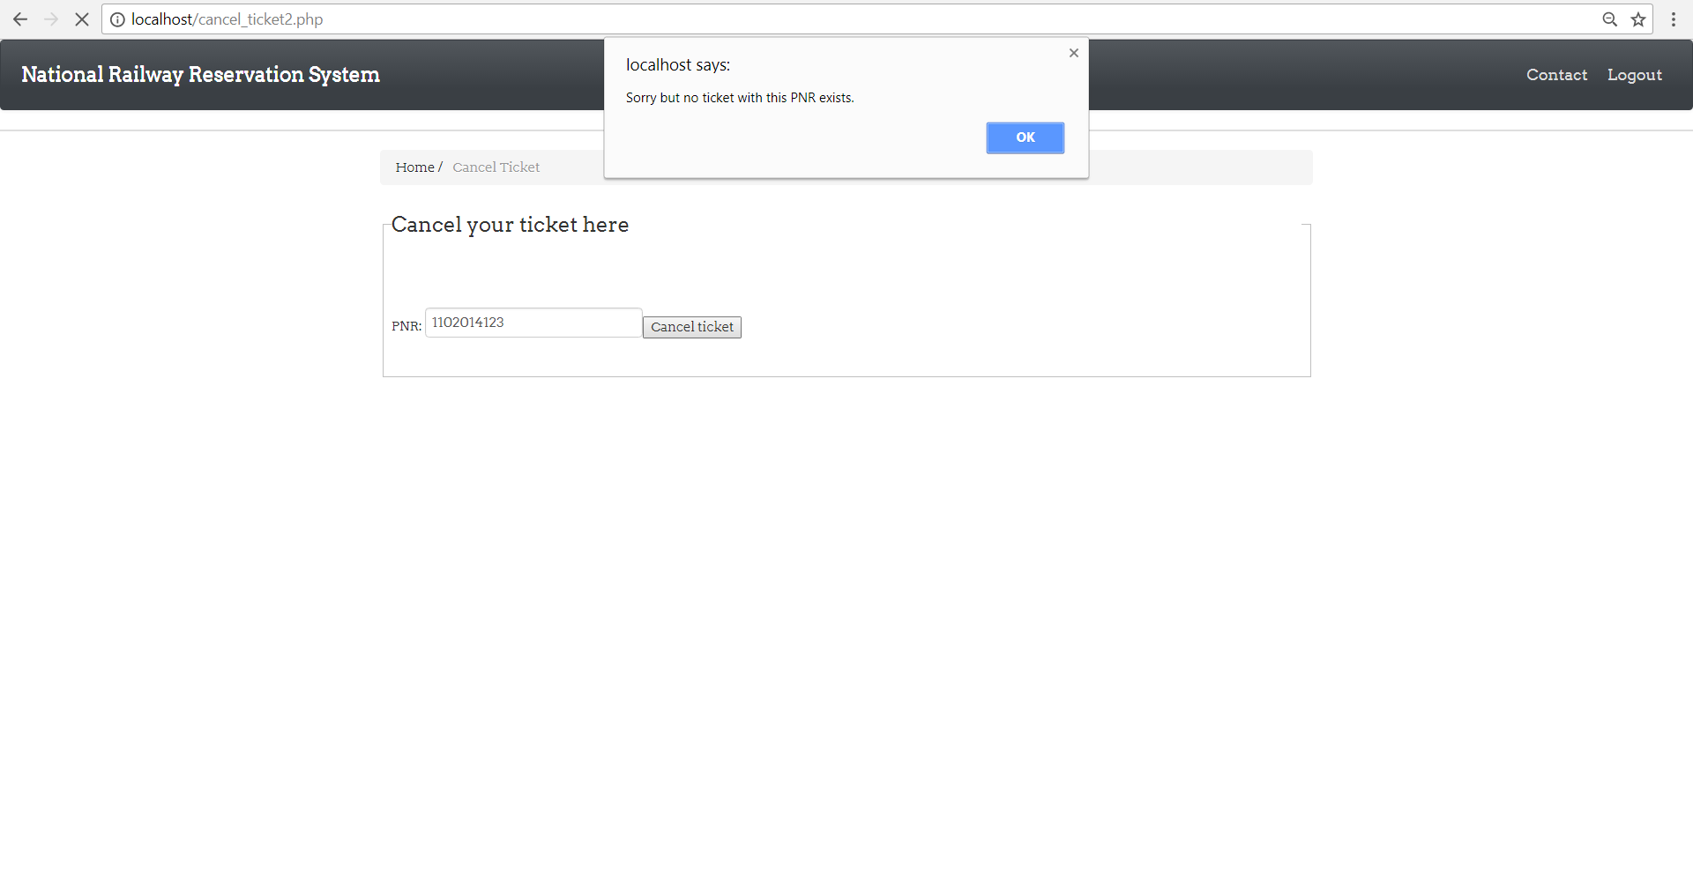
In case a wrong PNR is entered (PNR that does not exist), alert box appears with message as shown.

Slide 30
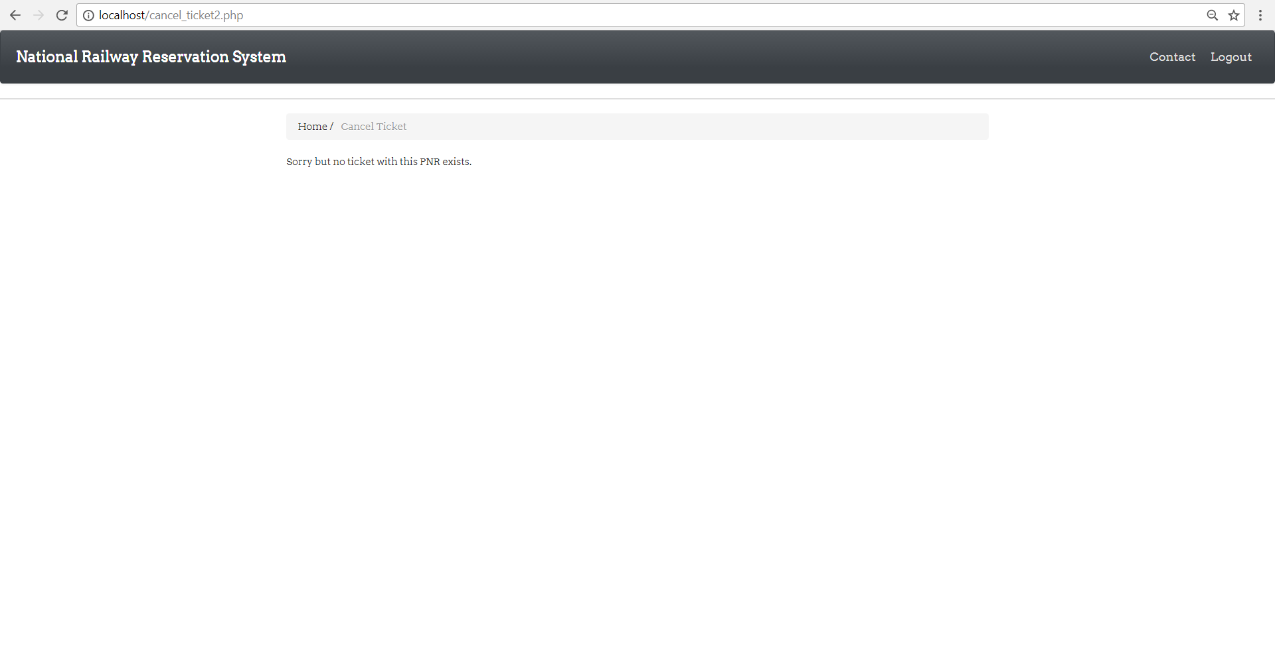
Also, message is printed on a page.

Slide 31
16. A ‘Register’ option is available for a non user to register in the login page.

Slide 32
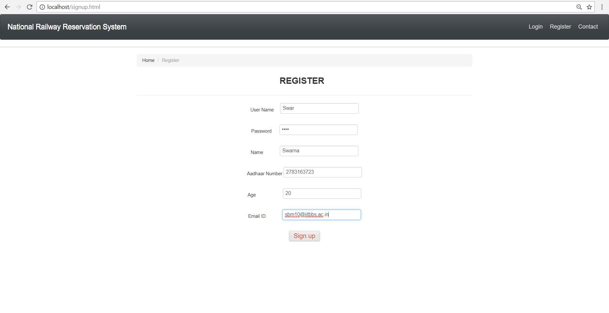
17. On clicking the link, the user is navigated to a page where his/her details are collected. On clicking ‘Sign up’ button, a message is delivered that the user is registered.

Slide 33
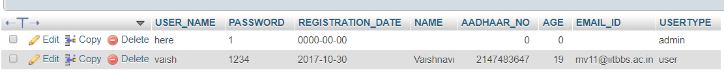
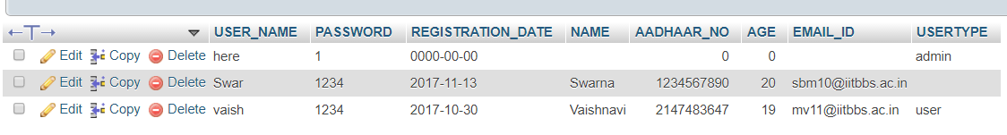
The details of the registered user are set to the ‘user’ table in the database. Here are the before and after screenshots of the ‘user’ table.

Slide 34
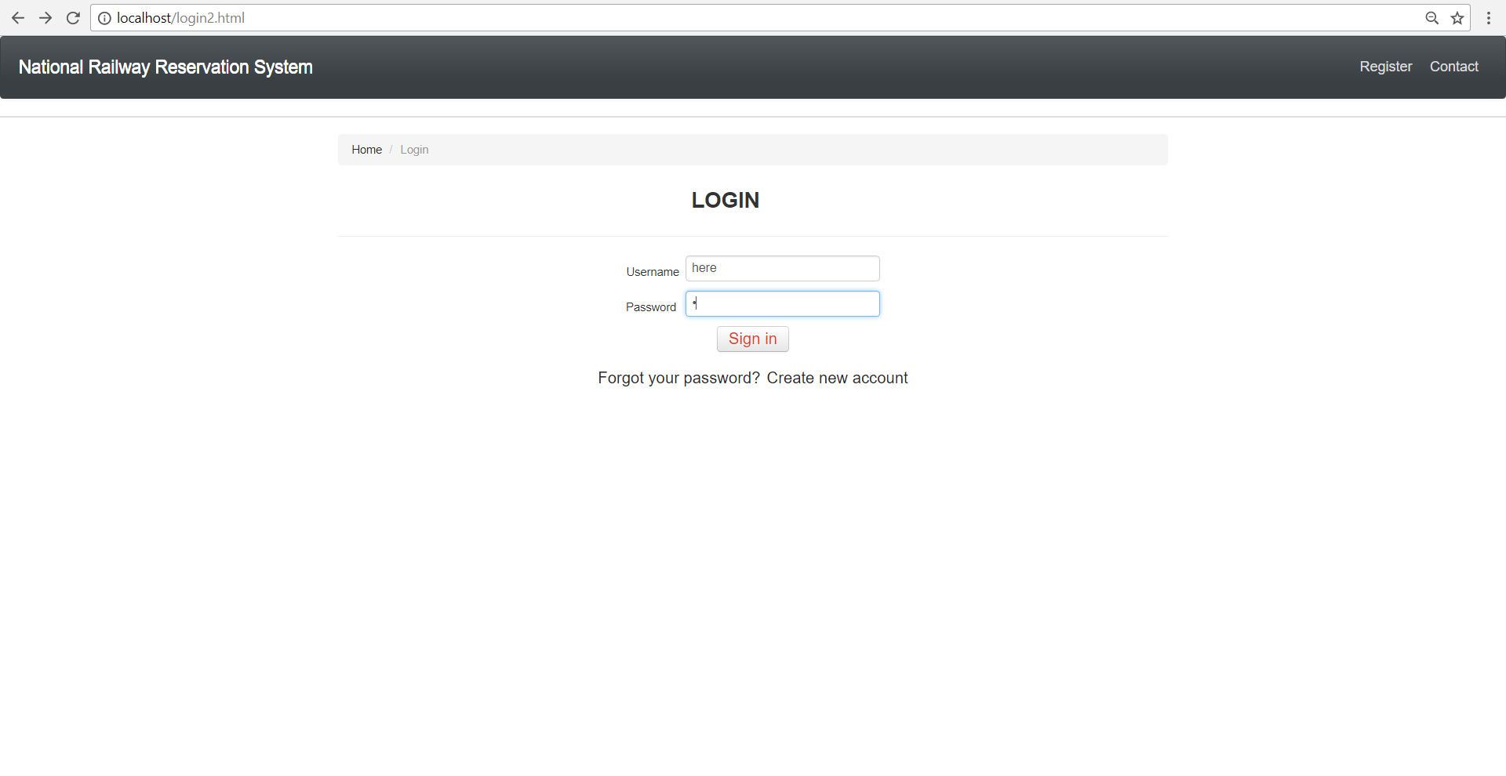
18. Now, if the user is ‘Admin’, the following operations will be available to be performed. Here we have an admin ‘here’. Let us check his/her access abilities. ‘here’ has to first login.

Slide 35
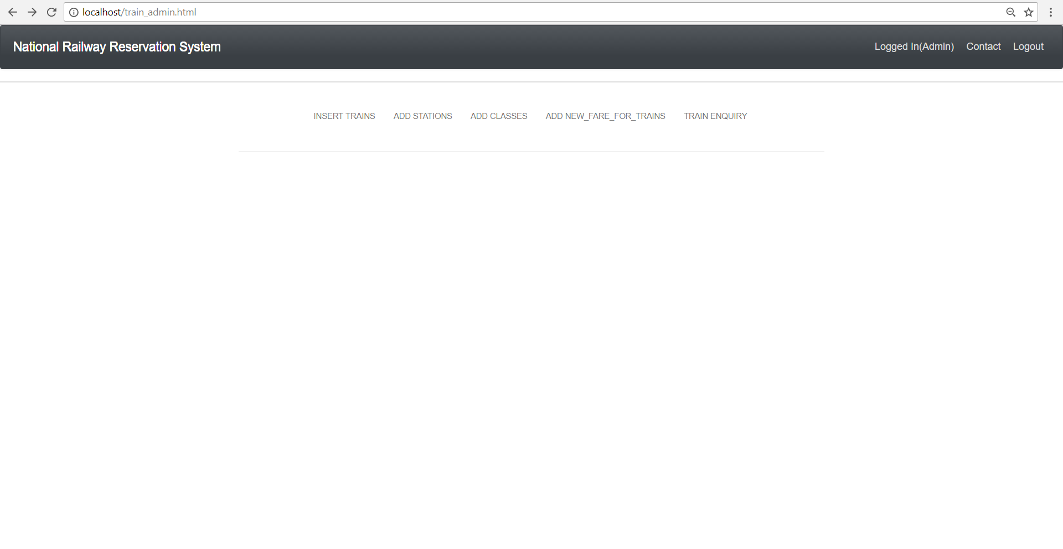
19. Once logged in, the following options will be available for the admin. Let us go through what can be done in each of these, with a check on database.

Slide 36
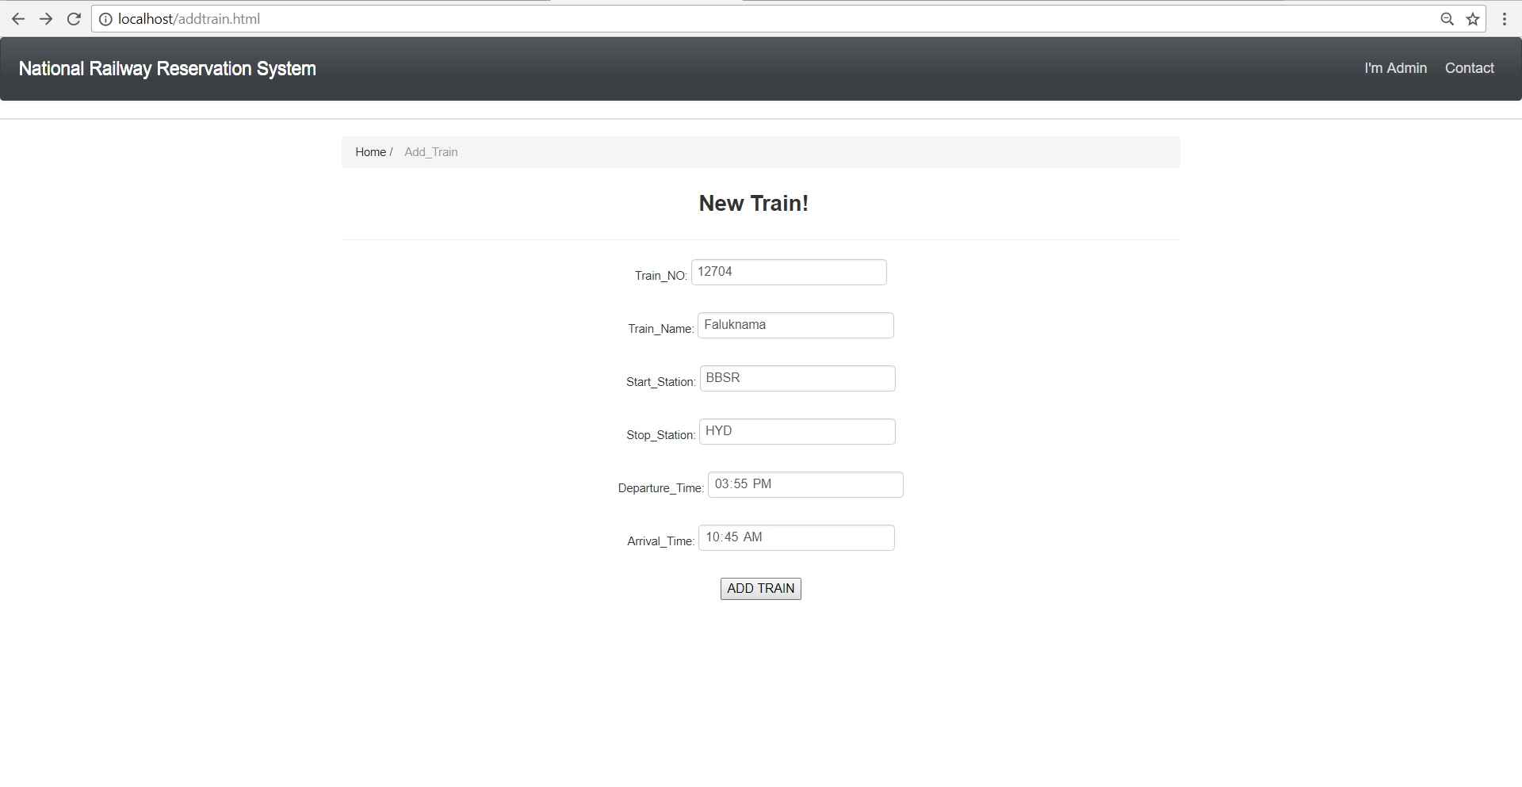
19. In case the admin chooses the ‘Insert trains’ to enter details of a new train, the following page appears. After entering the details, a click on ‘Add train’ will insert the details into the ‘train’ table in the database.

Slide 37
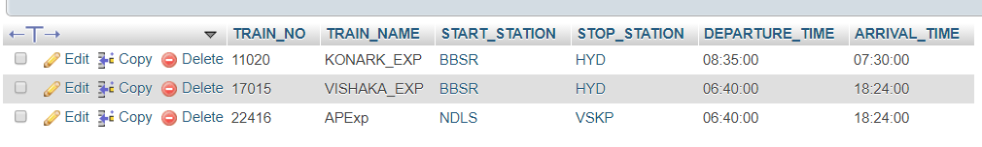
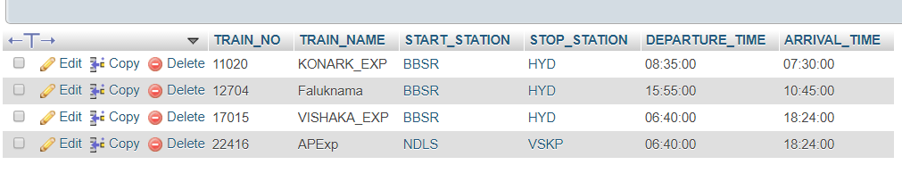
The before and after screenshots of the train table is shown.

Slide 38
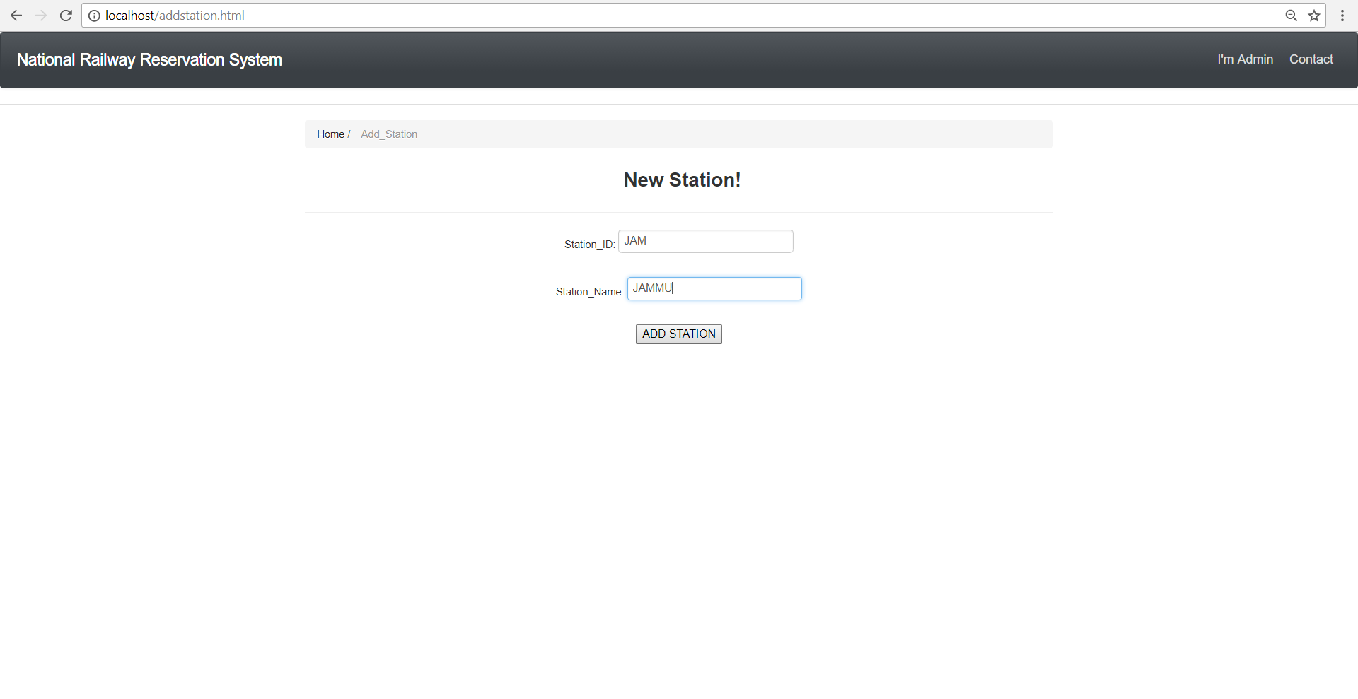
20. In case the admin chooses the ‘Add station’ to enter details of a new train, the following page appears. After entering the details, a click on ‘Add station’ will insert the details into the ‘station’ table in the database.

Slide 39
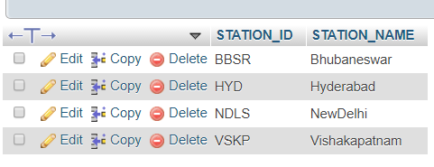
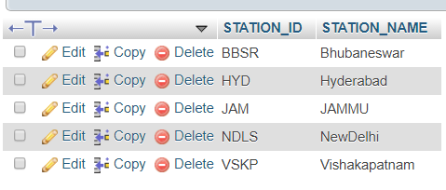
The before and after screenshots of the station table is shown.

Slide 40
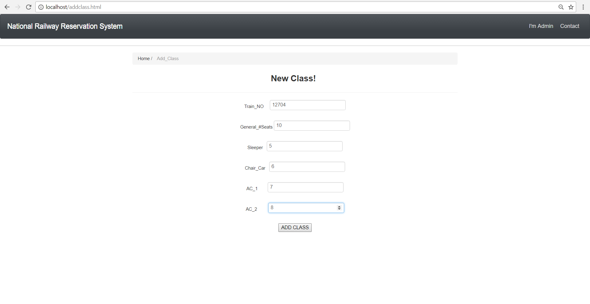
21. In case the admin chooses the ‘Add class’ to enter details of a new train, the following page appears. After entering the details, a click on ‘Add class’ will insert the details into the ‘class’ table in the database.

Slide 41
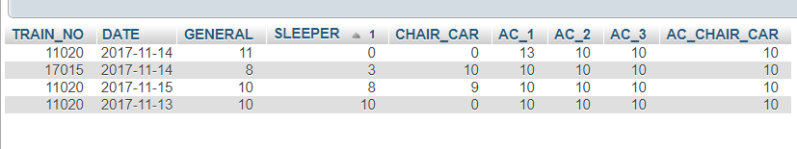
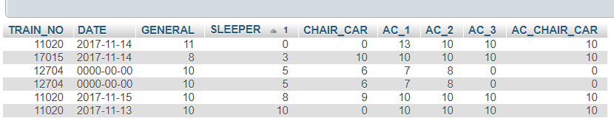
The before and after screenshots of the class table is shown.

Slide 42
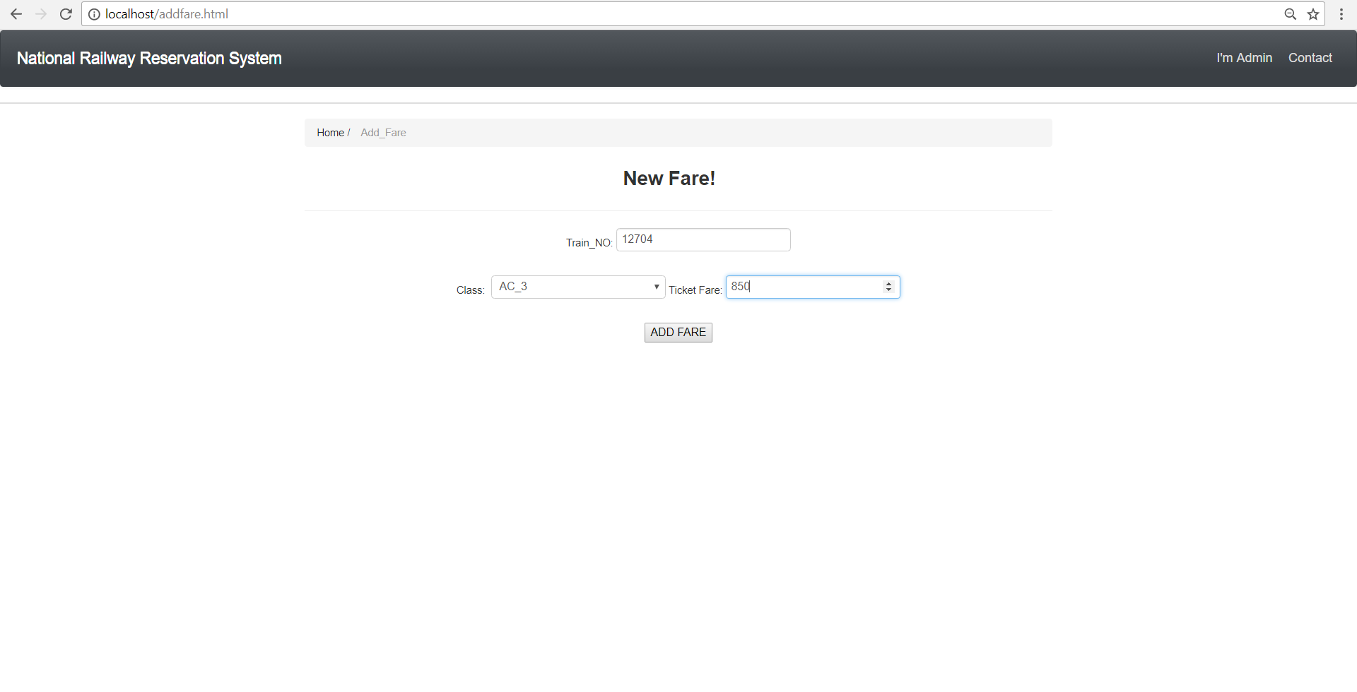
22. In case the admin chooses the ‘Add_new_fare_for_trains’ to enter details of a new train, the following page appears. After entering the details, a click on ‘Add fare’ will insert the details into the ‘class’ table in the database.

Slide 43
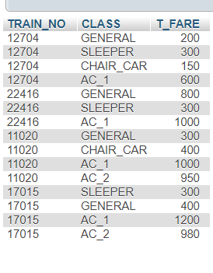
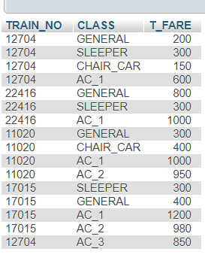
The before and after screenshots of the class table is shown.

Slide 44
LIMITATIONS AND FUTURE PLANS
Fee payment is not included. It can be included by navigating to fee portal through cards, when pay
button is pressed. A Receipt No can be generated after successful payment and can be inserted in
the payment table, which is the primary key in Payment table.
If we want to cancel only one passengers ticket, when booked together with other passengers, then
there may be some problem, since we have generated a PNR number for a ticket which can contain
multiple passengers.
Train and PNR status can be displayed. These feature can be added.

Slide 45
THANK YOU!
M. VAISHNAVI 15CS01011
M. SWARNA BHARATHI 15CS01018

